Slide 1
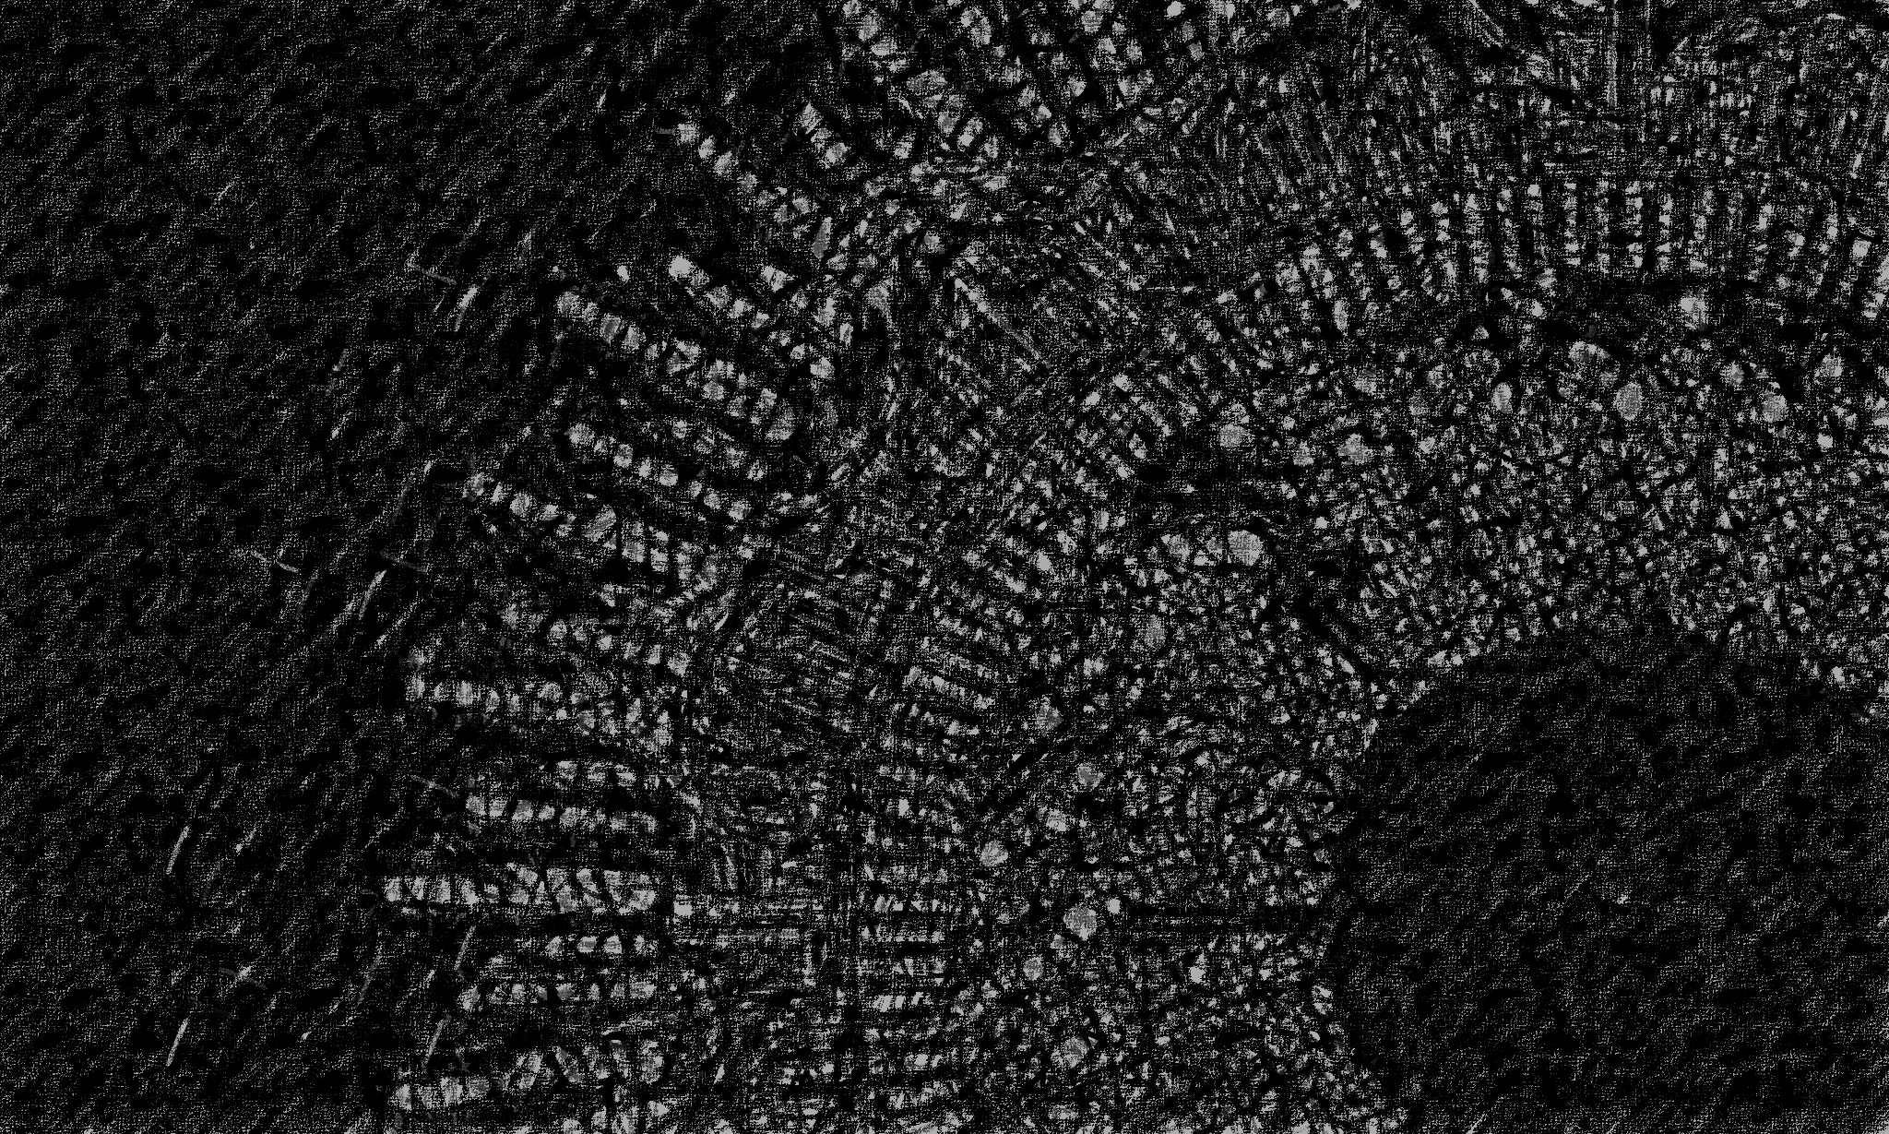


AI Workshop 3: Neural Networks (Online) Saturday 1st March 2025
Omar Choudhry

Slide 2

Learning Objectives
By the end of this lesson, you will learn:
What is a neural network?
What are weights and bias’?
What is an activation function?
What is forward propagation?
What is backward propagation?
What is gradient descent?
How can you build a simple neural network?

Slide 3
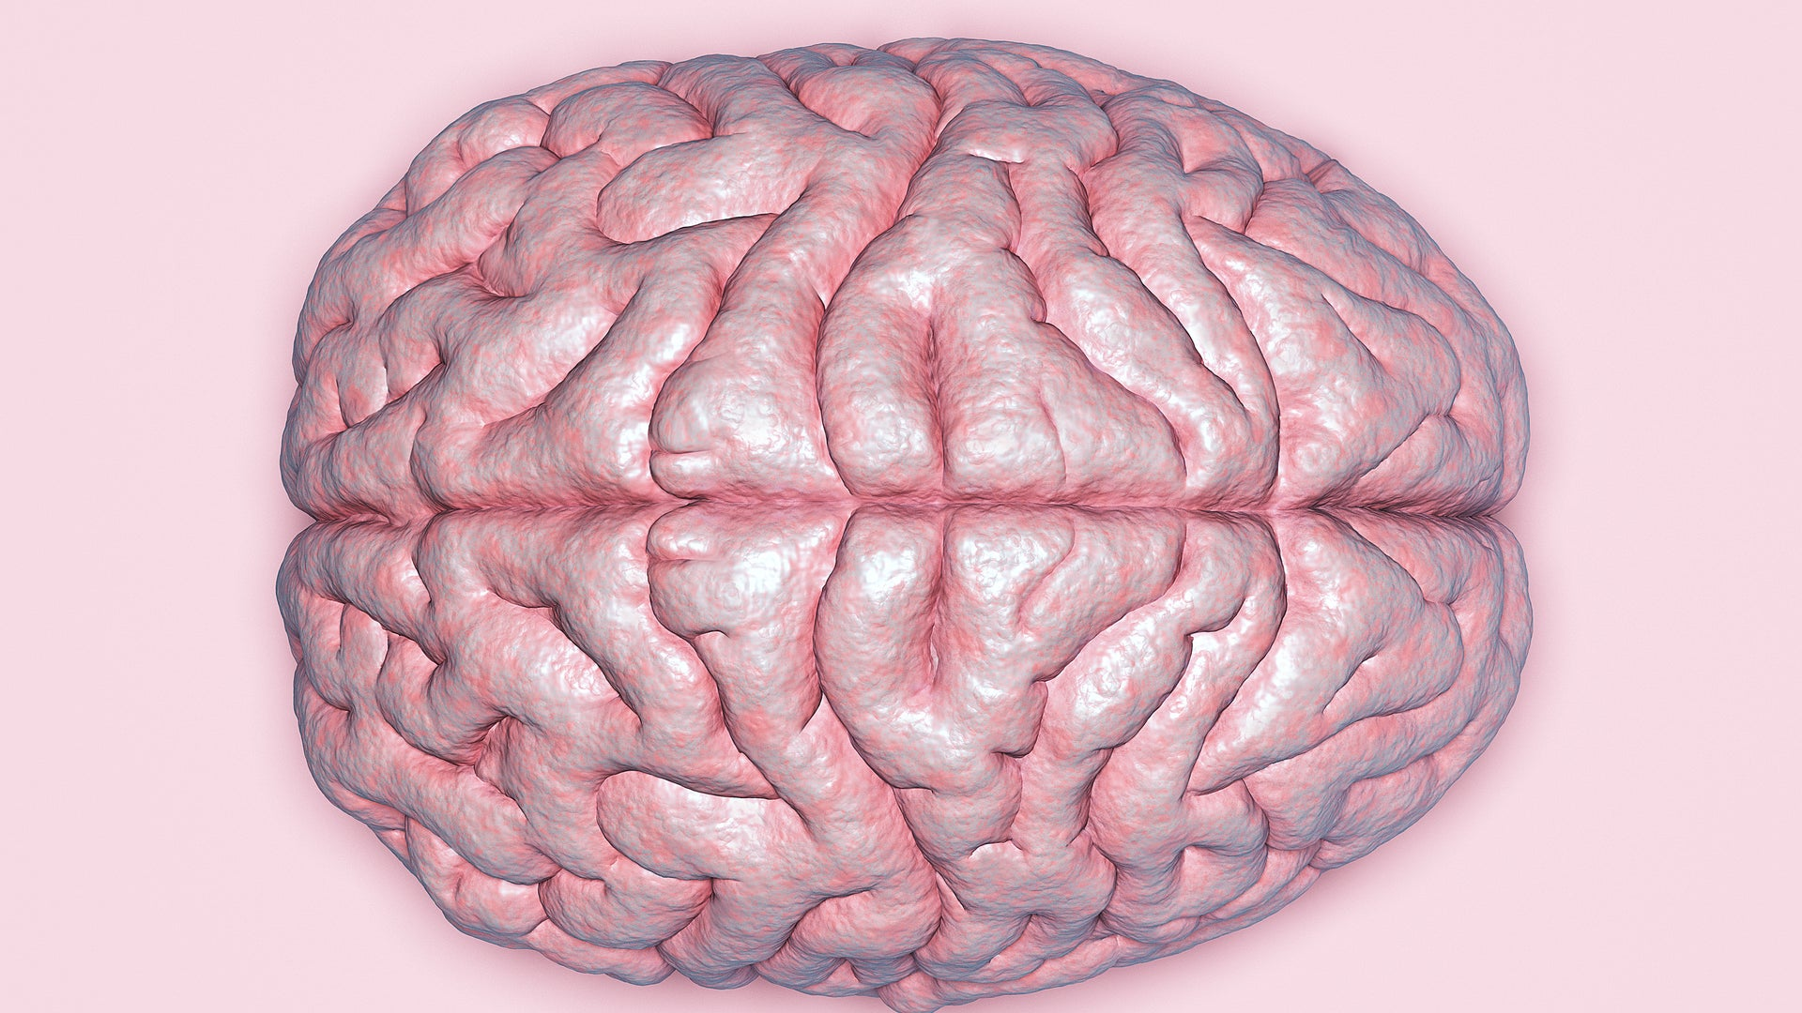
The Human Brain

Slide 4
Biological Neurons
86 billion neurons
Trillions of connections (synapses)
A developing foetus creates 250,000 neurons per minute
Each neuron is connected to roughly 1000 other neurons

Slide 5
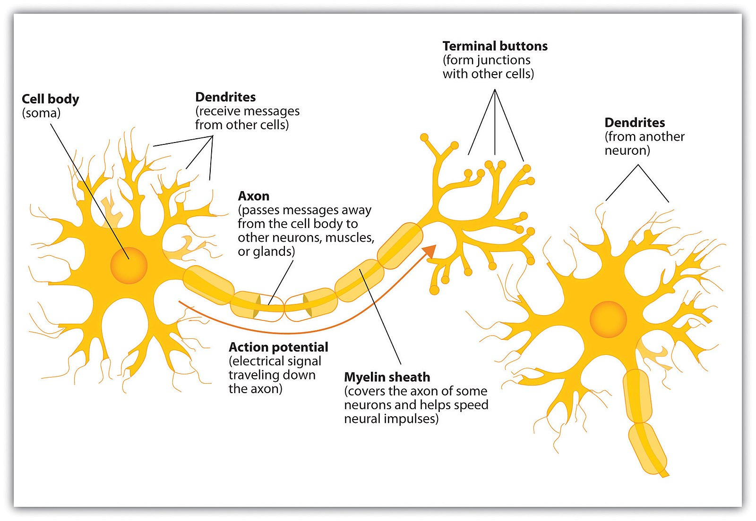
Biological Neurons

Slide 6
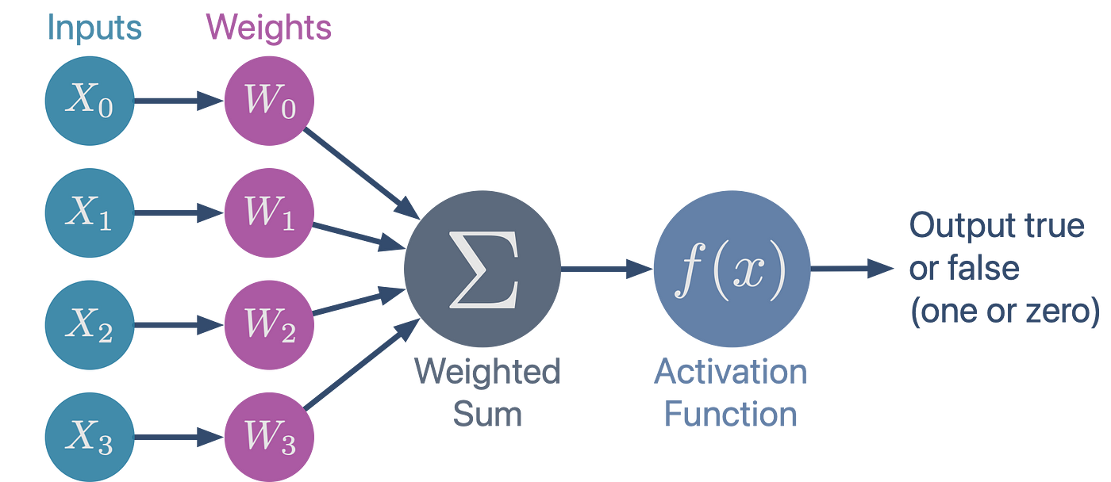
Perceptron
The most basic neural network

Slide 7
Forward Propagation

Slide 8
Multilayer Perceptron
Combining multiple perceptrons together

Slide 9
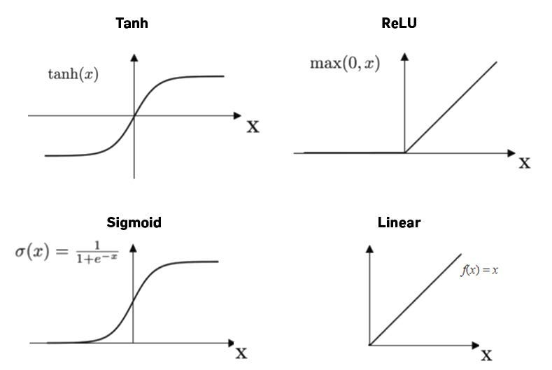
Activation Functions

Slide 10
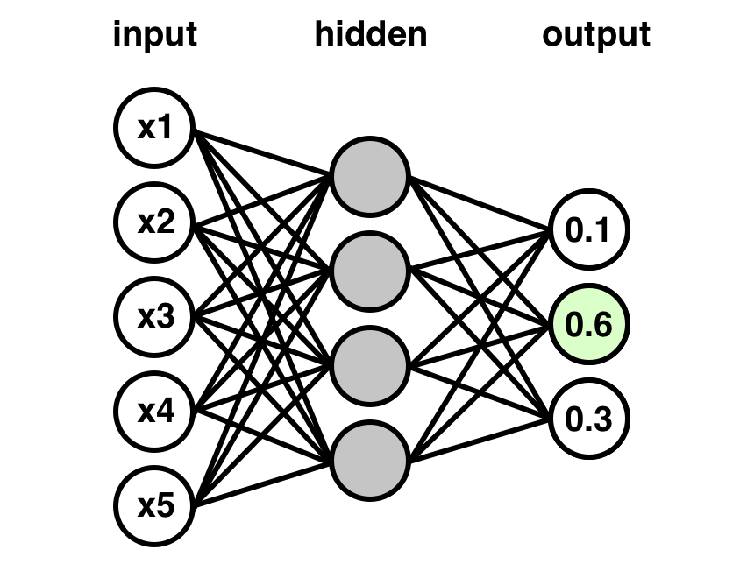
Neural Networks

Slide 11
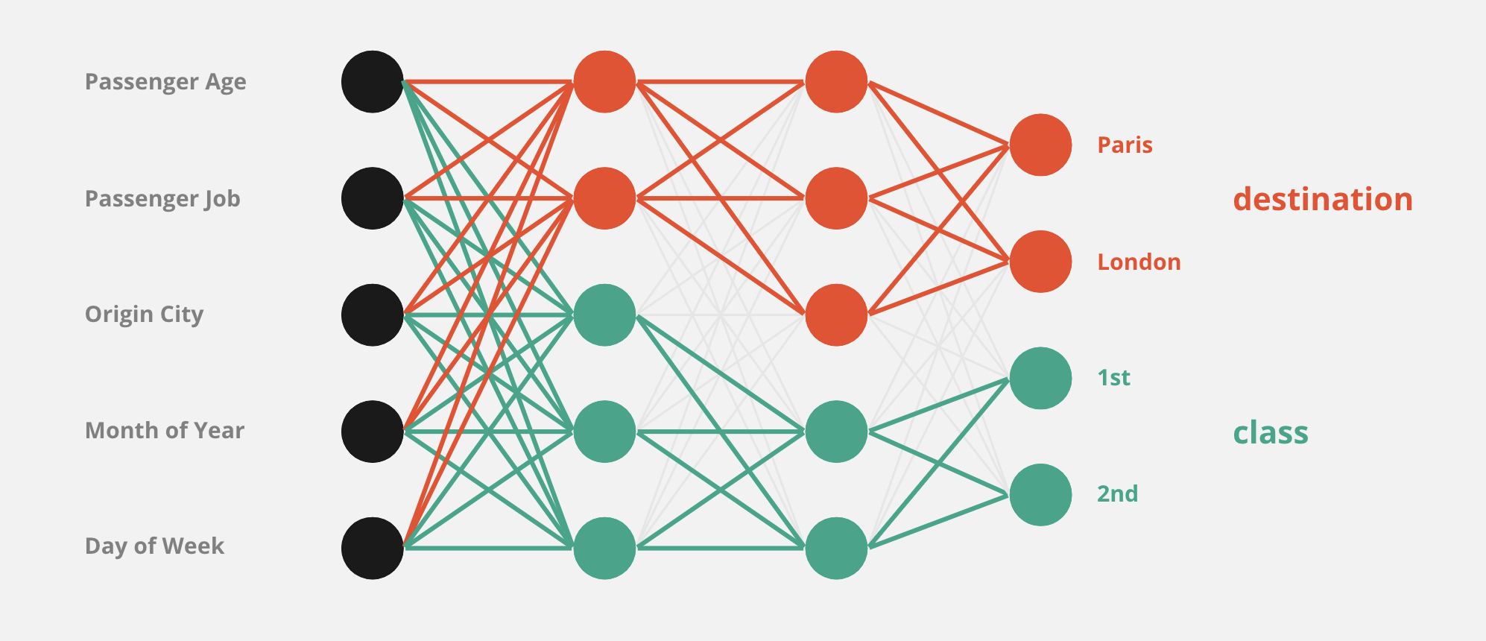
Multiple Output Neurons

Slide 12
Backward Propagation

Slide 13
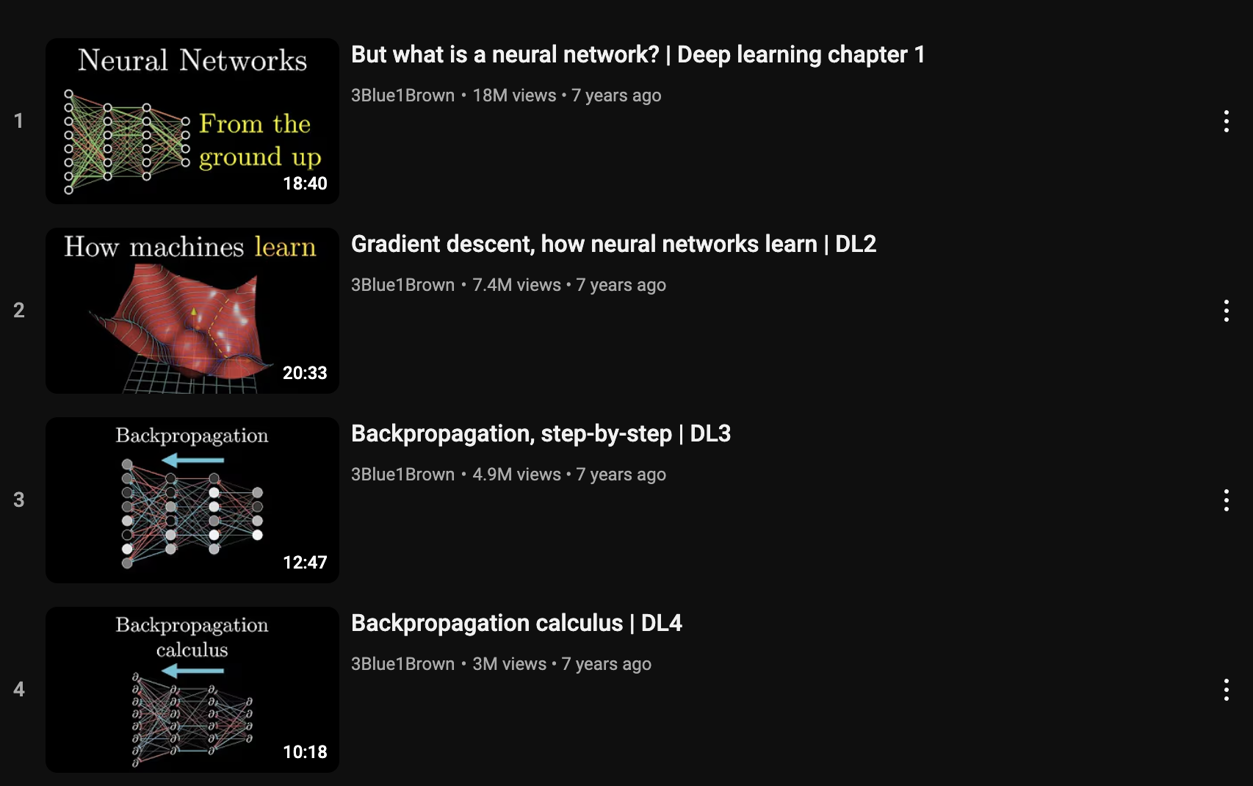

Backward Propagation

Slide 14
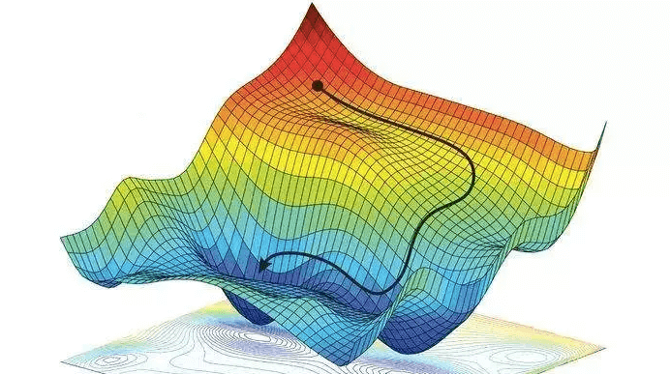
Visualising Gradient Descent

Slide 15
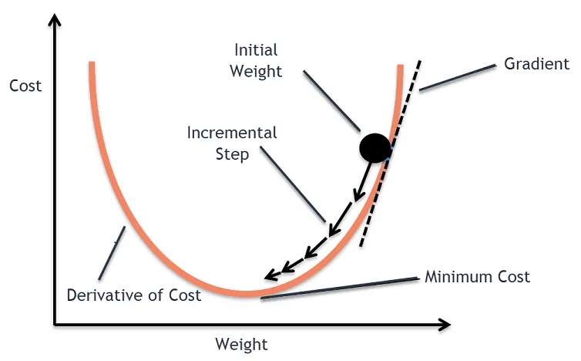
Gradient Descent

Slide 16
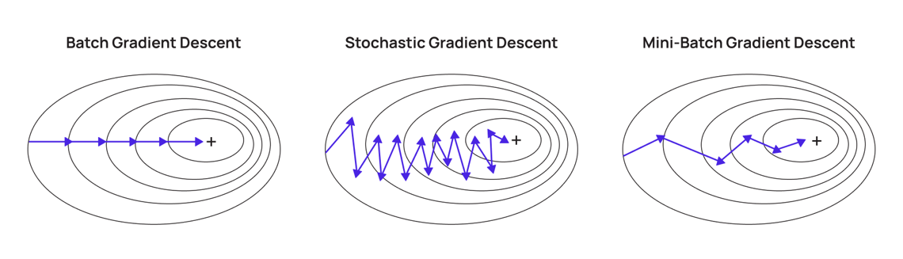
Types of Gradient Descent
Sample of inputs
from training batch
All inputs in training batch
Every input

Slide 17
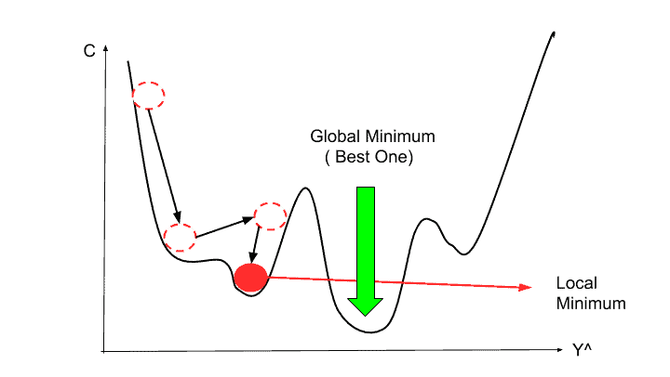
Local vs Global Minimums

Slide 18
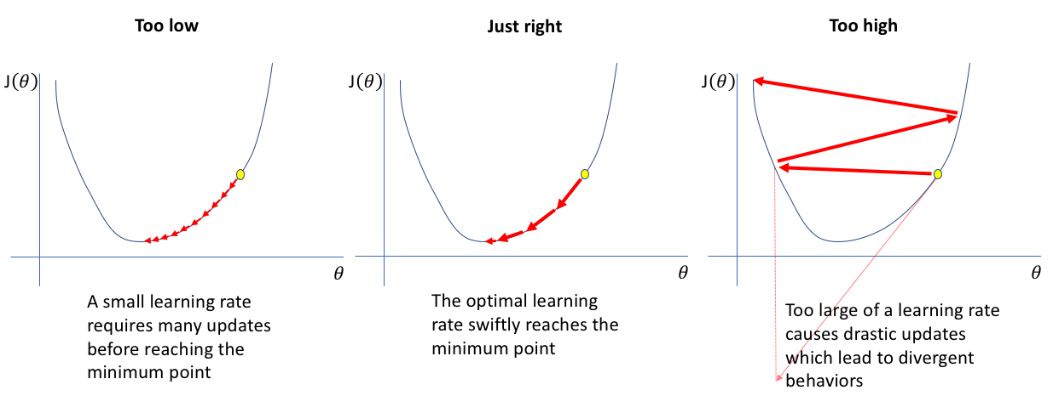
Learning Rate

Slide 19
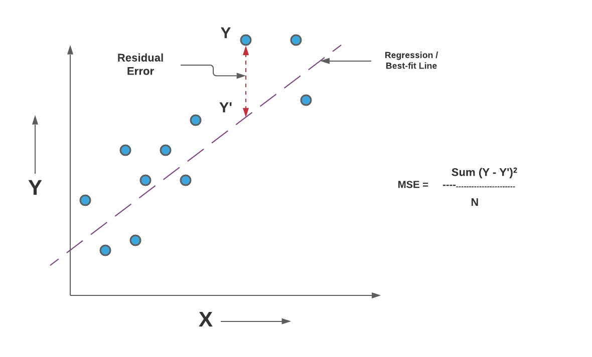
Loss Functions

Slide 20
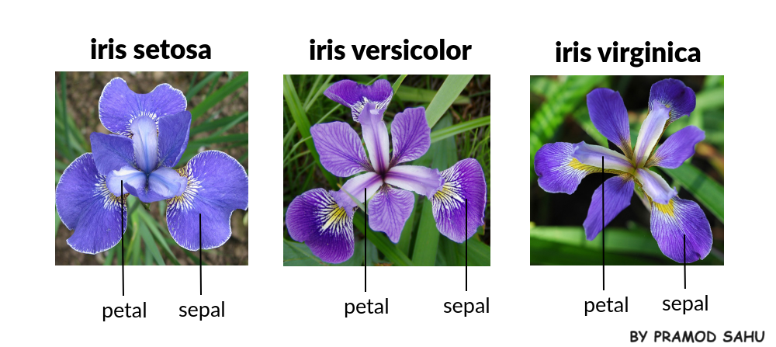
Building a Neural Network

Slide 21
Building a Neural Network
Website: https://playground.tensorflow.org/
Repository: https://github.com/omariosc/aisoc-workshops
Google Colab: https://colab.research.google.com/
Upload the notebook.ipynb file from the Workshop 3 folder

Slide 22

Problems?

Slide 23

Problems?

Slide 24

Problems?

Slide 25


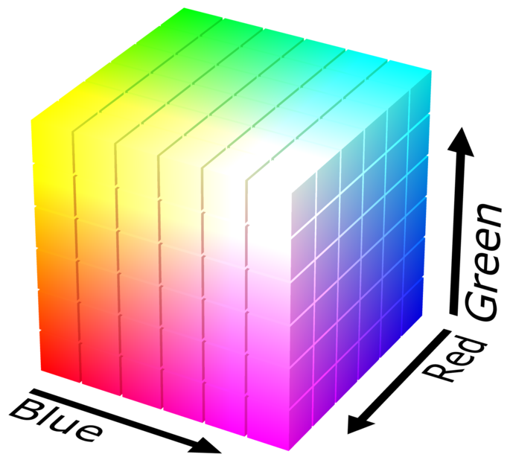
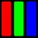
Images
…
#AEC088
(174, 192, 136)
…
…
…
…
…
…

Slide 26
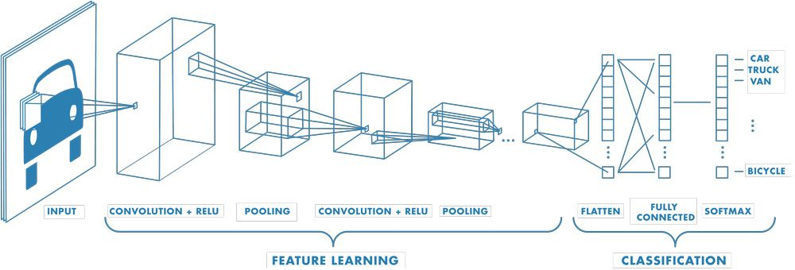
Convolutional Neural Networks

Slide 27
Simulating the Brain?
Human brain generates about 23 watts of power (enough to power a lightbulb)
Power source is renewable energy from food
Power efficiency is orders of magnitude higher than electronic computers
Can perform an exaflop (a billion-billion mathematical operations per second)
Most powerful computer performs 1.7 exaflops
But it uses 24.6 megawatts (246 000 000 watts)
Each human brain is 10 billion times more efficient

Slide 28



Slide 29


Contact
Contact
Slides are available at github.com/omariosc/aisoc-workshops
Feedback: https://forms.gle/gUpQ51utjH3D9WtSA
WhatsApp Community Chat
O.Choudhry@leeds.ac.uk

